Slide 1



Group 2
Realtors International
Real Estate Market Analysis and Prediction
Deepak (100834952) : Data Analyst
Joumana (100832624): Technical Manager
Tianyi (100822127): Business Analyst

Slide 2

Company Background
Company Introduction
Problem Statement
Realtors International is a real estate consulting firm, regarding project evaluation, quality appraisal, measurement and valuation, purchase procedures & relevant laws. They are able to meet needs of key stakeholders (investors, consumers and real estate operators) with data revolving around investment environment, market information (supply and demand information, customer credit, .
Real-estate developers may not have key insights into future housing prices. The objective of our capstone is to help facilitate those insights. Predicting which methods could better predict housing prices(based on key variables) will not only benefit the real-estate developers but also the community.
Industry Background
The housing market contains so much potential and there are many people involved in this industry. Buying a house is a huge cost for most people so they definitely do not want to waste money and time living in someplace uncomfortable. How to choose a suitable house for buyers become an important issue in this industry.

Slide 3
Industry Analysis
Strengths
S
W
Weakness
Understand the local market and industry better.
International backup team which could attract customers from all over the world.
The availability of data in the market and usefulness of this data.
Unexperienced employee with poor workout.
Lack of industry policy guidance and supervision.
O
T
Opportunity
Threats
New real-estate markets .House price raising.
Targeting a large scale of customers interested and involved in the industry.
Competitors.
Uncertainty of the market and unpredictable situations.

Slide 4
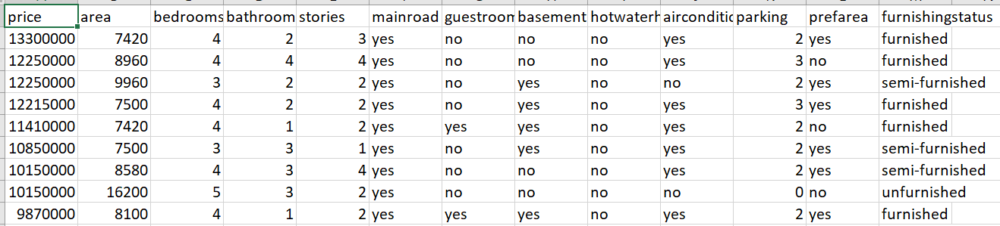
Data Mining & Description
The data is from the Kaggle Platform, which provides information about housing prices based on various factors. See link https://www.kaggle.com/chiranjeevbit/housedata/version/1
These various features help us predict which are the best locations and the best type of unit to construct. We have 12 variables contributing to price (area, bedrooms, bathrooms, stories, main-road, guestrooms, basement, hot water, air conditioning, parking, and furnishing)
Sample of data with top 10 rows and 13 columns

Slide 5
Tools and Challenges
Tools
Challenges
EXCEL: Using excel to manipulate and clean the dataset.
PYTHON: Using python to describe the dataset and analysis the dataset through different prediction and classification methods.
PowerBI: Using PowerBI to visualize the dataset and give more straightforward insights.
The data set is small and having more data would be beneficial.
The model tends to be biased removing less important features was not very efficient , this might again be because the data set is small.

Slide 6
Methods
Data Cleaning
Evaluation
Processes
The Data was cleaned in three processes
1- Removing Nulls.
2-Removing duplicates.
3-Removing Outliers
1-Finding important features using back word selection.
2-Comparing the performance of Linear Regression , when having all features and only important features.
3-Applying SVM, LDA, QDA, Logistic Regression to predict if it is a prefered area or not and is it a main road or not .
4-Using power Bi to analyze current state
Key metrics we have looked through all methods:
R2 and Adjust R2, F1-score, Accuracy, Weight Accuracy, Unit Price and so on.

Slide 7
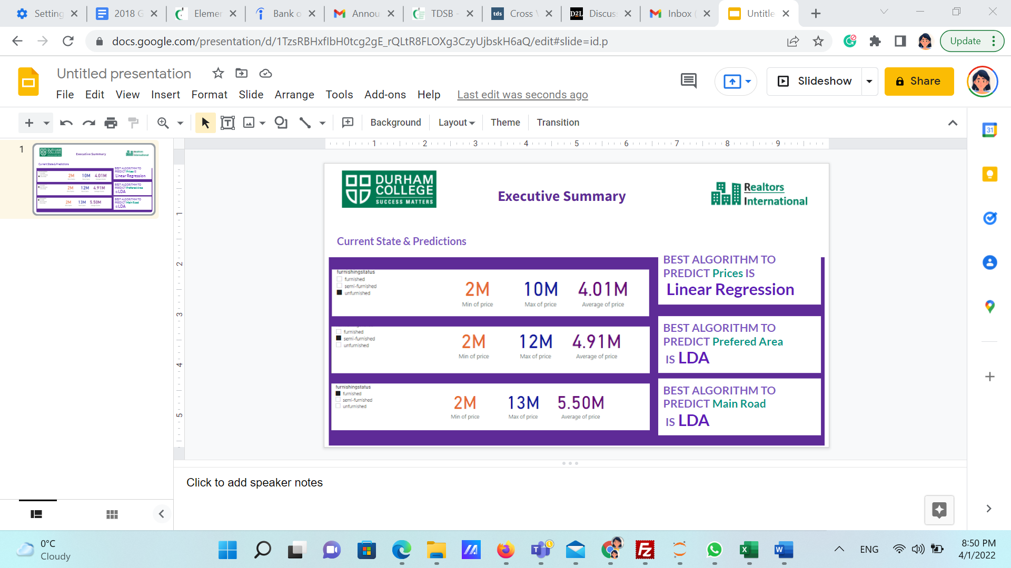
Conclusions

Slide 8
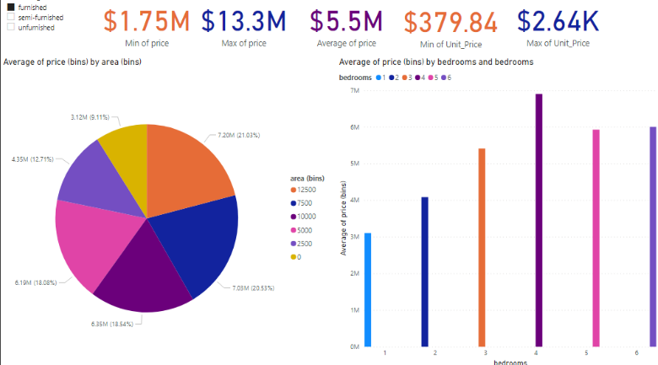
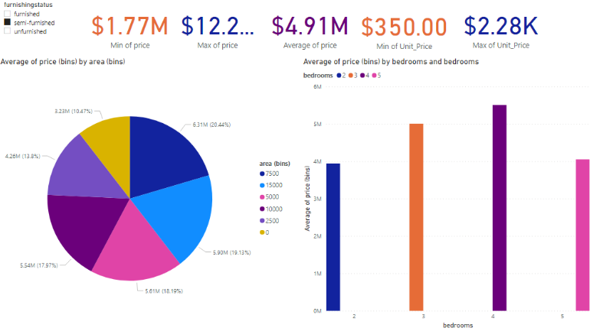
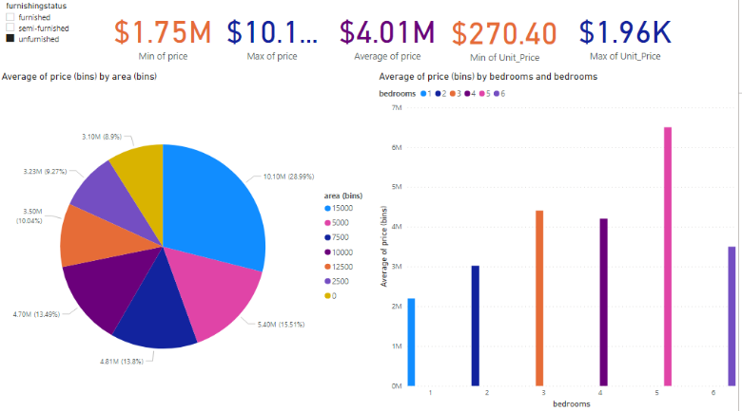

Slide 9
Implications
Having as many features as possible made the model perform better than selecting important features.
LDA performed the best without any enhancements
Linear Algorithm
LDA
Other classification Algorithms
When enhancing our code –applying grid search for example
Other algorithms like logistic regression and QDA, both performed the best after enhancement.

Slide 10

Recommendations
We will use Tensor Flow and React native open framework to leverage this prediction algorithm in creating mobile app.
We can use power automate to make sure the data is up to date in an excel sheet.

Slide 11
Q & A?
Thanks

